Slide 1





Nephron Final Presentation
Drug Pricing Analysis
neph·ron/ˈnefrän/ noun: The functional unit in the kidney which filters waste from what is essential for life
Nephron has emerged as an important voice on managed care and pharmaceutical supply chain policy and economics, helping manufacturers and supply chain participants navigate the increasingly complex Payor/PBM marketplace
Founded in 2017 by Eric Percher and Josh Raskin, Nephron Research has established itself as the market’s leading independent healthcare equity research provider, filtering market noise from the insights that are essential to the investment process

Slide 2

The Problem
How can Nephron provide their clients with actionable insights and predictions for investments? More specifically, how will drug prices for different classes behave in the future?
For the Columbia Team, can we find patterns among various drug groups and build a predictive model to anticipate drug price changes?
2

Slide 3

Data, Methods, and Analysis
1
Data
~5 years of historical branded drug prices and volume, along with categorical data, such as drug class.
Methods
Perform exploratory data analysis to understand how and when drug prices change
Use these findings to create a predictive model for drug prices
Analysis
We found patterns and strong seasonality among drug pricing changes
Used the Prophet model, which works well with time series that have strong seasonal effects, such as we observed with our historical drug pricing data.
2
3
3

Slide 4
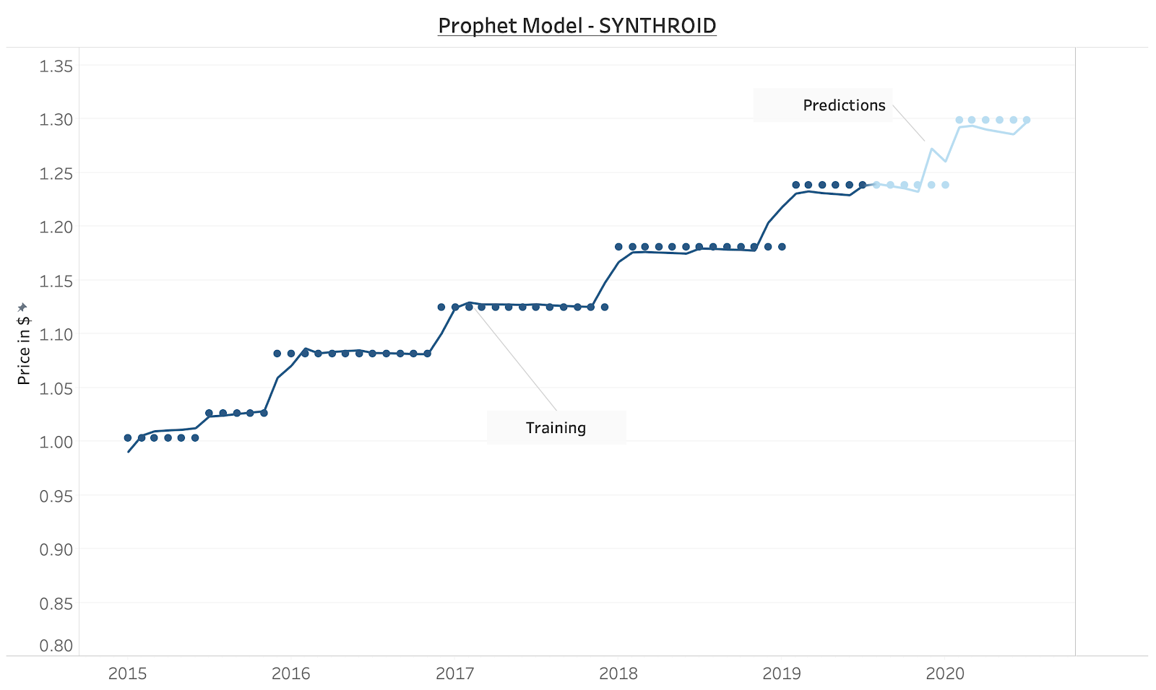
Predicting Individual Drug Price Changes Using Prophet
WAC Price
4

Slide 5
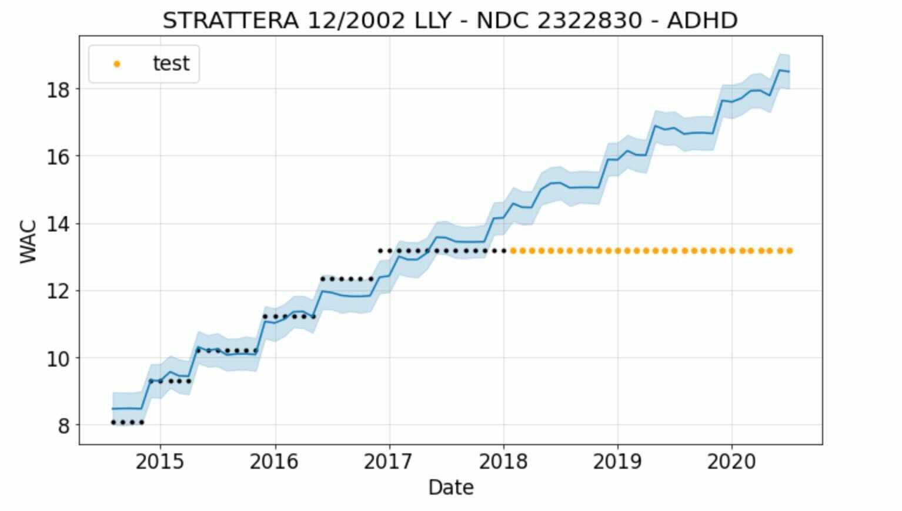
Prophet Model for Predicting Drug Prices Was Not Accurate for ~17% of the Drugs in Our Dataset
WAC Price
5

Slide 6
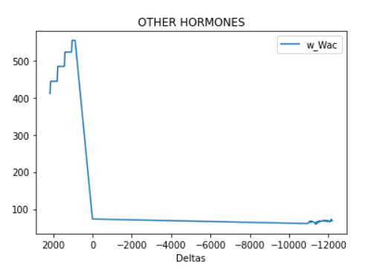
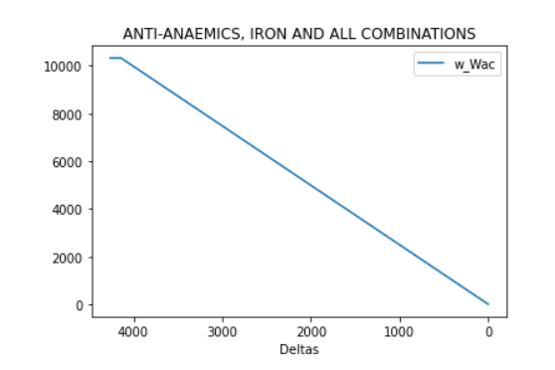
Insight: As drug Approaches Loss of Exclusivity Date, New Pattern Emerges
Sales-Weighted WAC Price
Sales-Weighted WAC Price
6

Slide 7
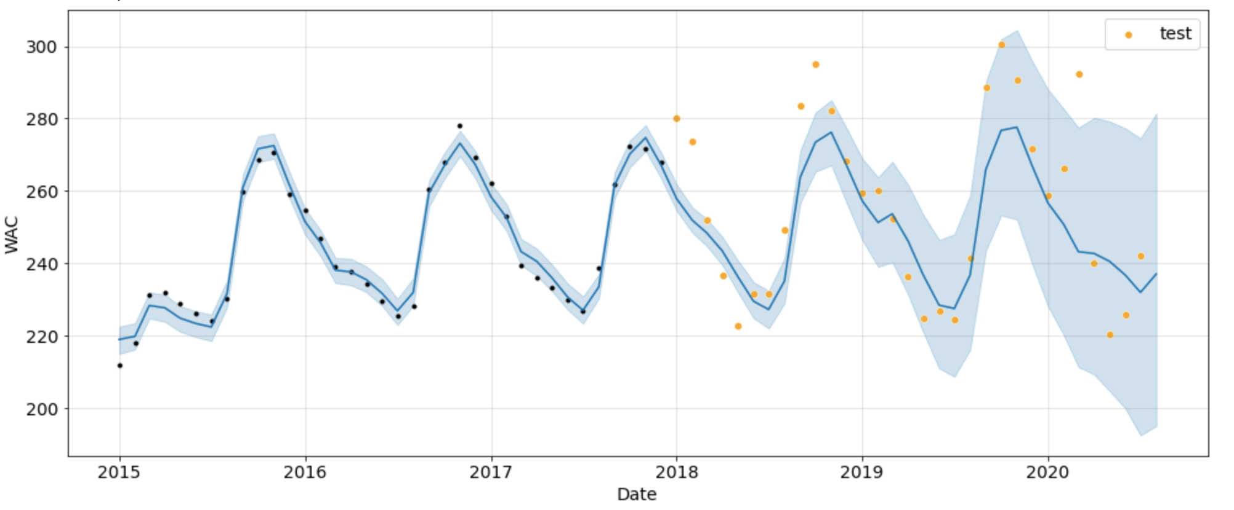
Updated Model
Prophet model on drug class instead of individual drug level
Universe excludes drugs approaching loss of exclusivity date
Sales-Weighted WAC Price
7

Slide 8
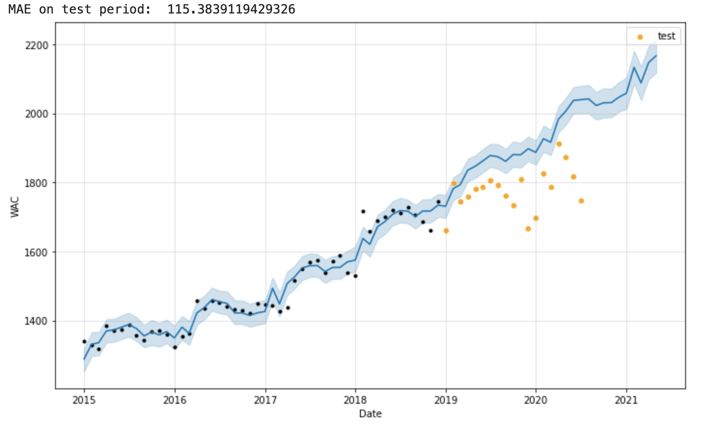
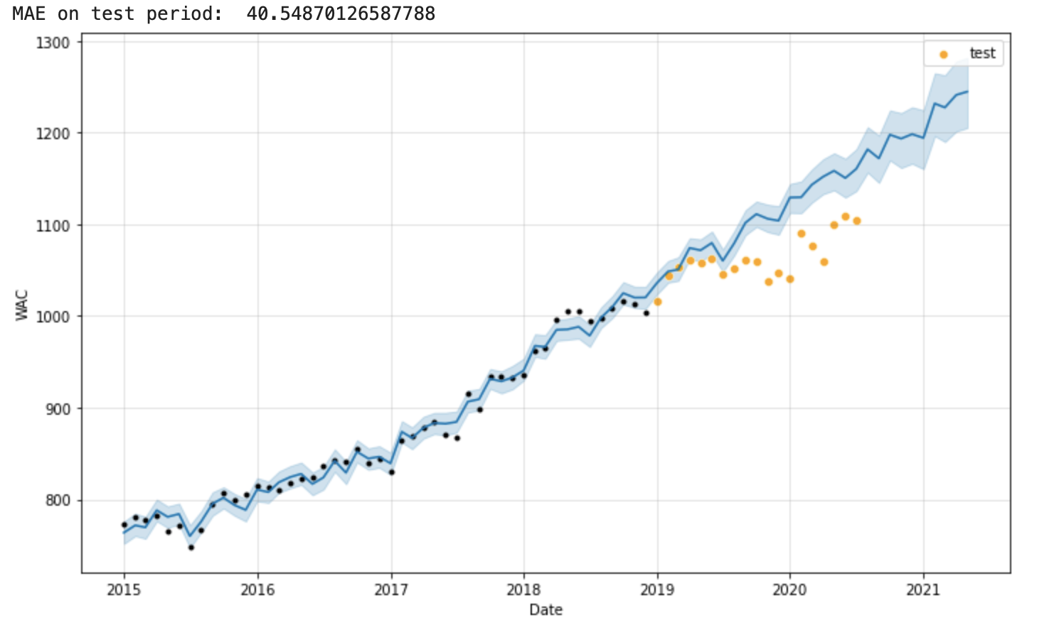
Updated Model
Without exclusion of drugs near expiration
With exclusion of drugs near expiration
Sales-Weighted WAC Price
Sales-Weighted WAC Price
MAE: 115.4
MAE: 40.5
8

Slide 9
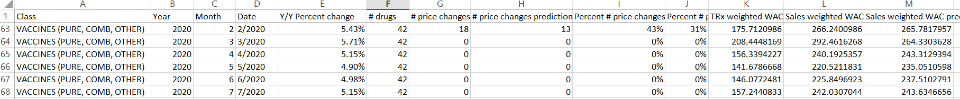
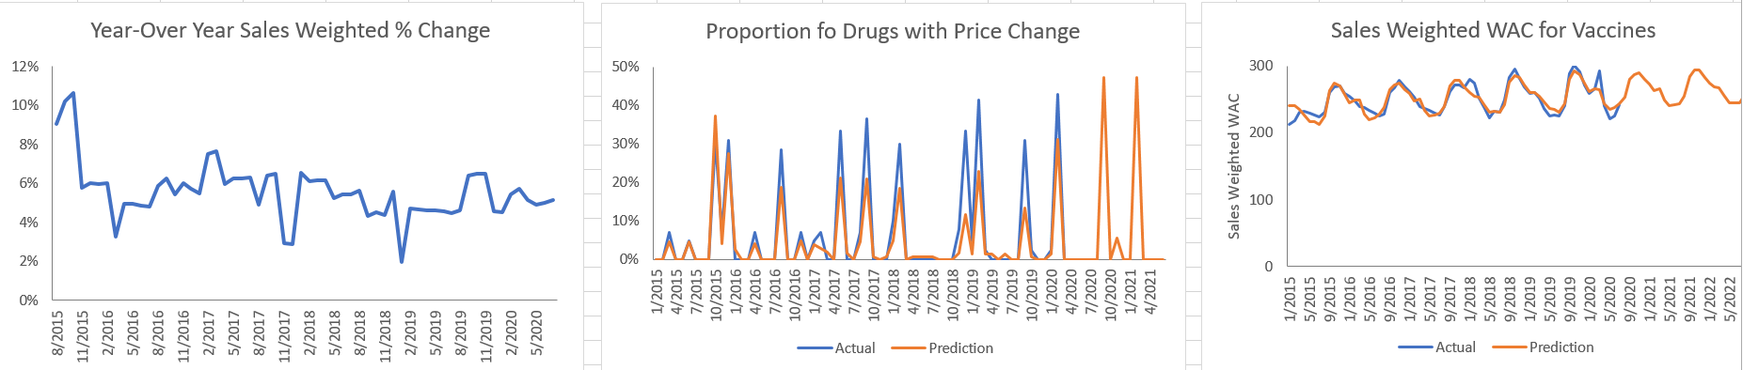
Summary and Deliverable: Building a Dashboard for Nephron with Actionable Insights
9

Slide 10
Vaccine Sales-Weighted Prices Are Seasonal
10

Slide 11

Immunology Prices Are Accelerating, While Oncologics Are Predicted To Increase at a Slower, More Turbulent Rate
Immunology
Oncologics
11

Slide 12
Allergy Sales-Weighted Prices Predicted to Decrease in the Next Year
12

Slide 13
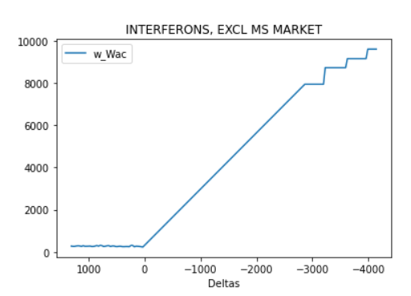
Future work and questions to consider
Incorporate drugs approaching loss of exclusivity date
Have a COVID vs non COVID model (current model includes COVID data)
Include entire universe of drug data (current model excludes drugs we do not have full history for)
Include other regressors, such as news sentiment.
13

Slide 14
Questions?

Slide 15
Appendix

Slide 16
Definitions
TRx – This measure represents the counts of total (new plus refill) prescriptions (scripts) dispensed by pharmacists
WAC - Wholesale Acquisition Cost
The manufacturer’s reported list price for a prescription pharmaceutical for sale to wholesalers
Each manufacturer establishes its own WAC by using its own formula.
Like AWP, WAC is a suggested price that often does not represent what a wholesaler or end-provider actually pays for the pharmaceutical, because WAC does not include manufacturer incentives such as rebates, volume purchase agreements, and prompt-payment discounts.
However, unlike AWP, WAC is statutorily defined in the U.S. Code:
The term “wholesale acquisition cost” means, with respect to a pharmaceutical or biological, the manufacturer’s list price for the pharmaceutical or biological to wholesalers or direct purchasers in the United States, not including prompt pay or other discounts, rebates or reductions in price, for the most recent month for which the information is available, as reported in wholesale price guides or other publications of pharmaceutical or biological pricing data.
Pros: Nationally standardized price (codified in legislation), broadly accepted, brands frequently updated, tied to supplemental rebates (increases to WAC will result in increases in supplemental rebates)
Cons: Semi-transparent, no oversight, not reflective of actual prices for brand or generic (but closer than AWP for brand), not comprehensive, generics not frequently updated, NCPDP endorsed replacement benchmark
16

Slide 17
Weighting Formula
Sales Weighted, Year-Over-Year WAC Price Change Rate = ∑ [(Specific Drug Sales / All Drug Sales for a given month) * Year-Over-Year WAC Price Change for each drug)]
Sales Weighting calculated for the entire drug market and for each drug class
Year-Over-Year WAC price change was recommended by Nephron to remove seasonal effects
Sales = WAC Price * TRx Volume
17

Slide 18
Methodology on Prophet model - class level
Prophet at the class level:
In order to forecast the price of whole drug classes, we came up with an aggregation method that best represent the real value of an entire drug class. We decided to compute the monthly Sales Weighted WAC across all drugs in the drug class, and fit our prophet model on that unit.
As said previously, we chose to exclude all drugs that had a short expiration date to prevent outlier behaviors in the forecast
Some parameters:
Daily and weekly seasonalities are not useful. We turn on yearly seasonality only.
Tuning the changepoint_prior_scale parameter to control the flexibility of model depending on class
Data: Around 10 of the most useful drug classes for Nephron Research
Regressors: We only use the sales weighted WAC average
18

Slide 19
Prophet model based on individual drug level
Methodology:
By modeling time series data of each drug, we could forecast the trend of this drug for the next 12 months and come up with predictions of drug price change month and change rate
By aggregating drug level prediction to drug class level, we could deliver results like for a certain drug class, percentage of drugs is predicted to increase price for each month.
19

Slide 20
Methodology on loss of exclusivity price pattern
Data:
Nephron’s drugs universe
Methodology:
Add a column with each drug patent’s expiration
Compute the Delta for each data point: Date difference between WAC’s timestamp and patent expiration⎼ The Delta is negative when the drug’s patent has expired
Group the data by drug class and then by Delta: For each drug class and at every time distance to expiration, we can compute the sales weighted average WAC
20

Slide 21
As We Broadened Our Focus to Predict Drug Price Changes at the Class Level, We Needed to Make Two Difficult Decisions with Significant Implications for Our Predictive Model’s Results
The Decision
The Reason
The Cost
Without enough historical data, our Prophet model was unable to make accurate predictions for price trends at the class level
Additionally, many drugs changed ID numbers due to indication changes. This discontinuous data resulted in inaccurate predictions
Our model can predict drug class price changes for existing drugs but is unable to predict the impact of new entrants
Drugs that change indications may be of interest to investors as new indications may lead to greater market share and prices for drugs
Exclude drugs that did not have data for entire time period (2015-2020) of dataset
1
Drugs that lose exclusivity face competition from generics, typically resulting in steep price declines
After a drug loses exclusivity, the historical price changes are unable to accurately predict future price changes
Loss of exclusivity and the entry of generics is a major driver of drug price changes
Our model will struggle to accurately predict price changes for drug classes that see a large proportion of drugs approaching expiration
2
Exclude Drugs that approached loss of exclusivity date
21

